Slide 1
TWITTER WORKSHOP
library(dplyr)
r-ladies_global %>%
filter(city = ’Melbourne')

Slide 2
Little guide
EDIT IN GOOGLE SLIDES
Go to the File menu and select Make a copy.
You will get a copy of this document on your Google Drive and will be able to edit, add or delete slides.
COLOR PALETTE
#181818
#D3D3D3
#88398A
#FFFFF
#562457

Slide 3



Hello!
I am Anna Quaglieri
I am PhD student at WEHI with a love for R and twitter. You can find me @annaquagli.
I am Saskia Freytag
I am post-doc at WEHI with a love for R and twitter. You can find me @trashystats.

Slide 4
1.
Why twitter?

Slide 5
- it’s as if they drove a clown car into a gold mine and fell in.
—Mark Zuckerberg
(on his rival social network twitter and the potential of their collected data)

Slide 6
2.
Getting started

Slide 7
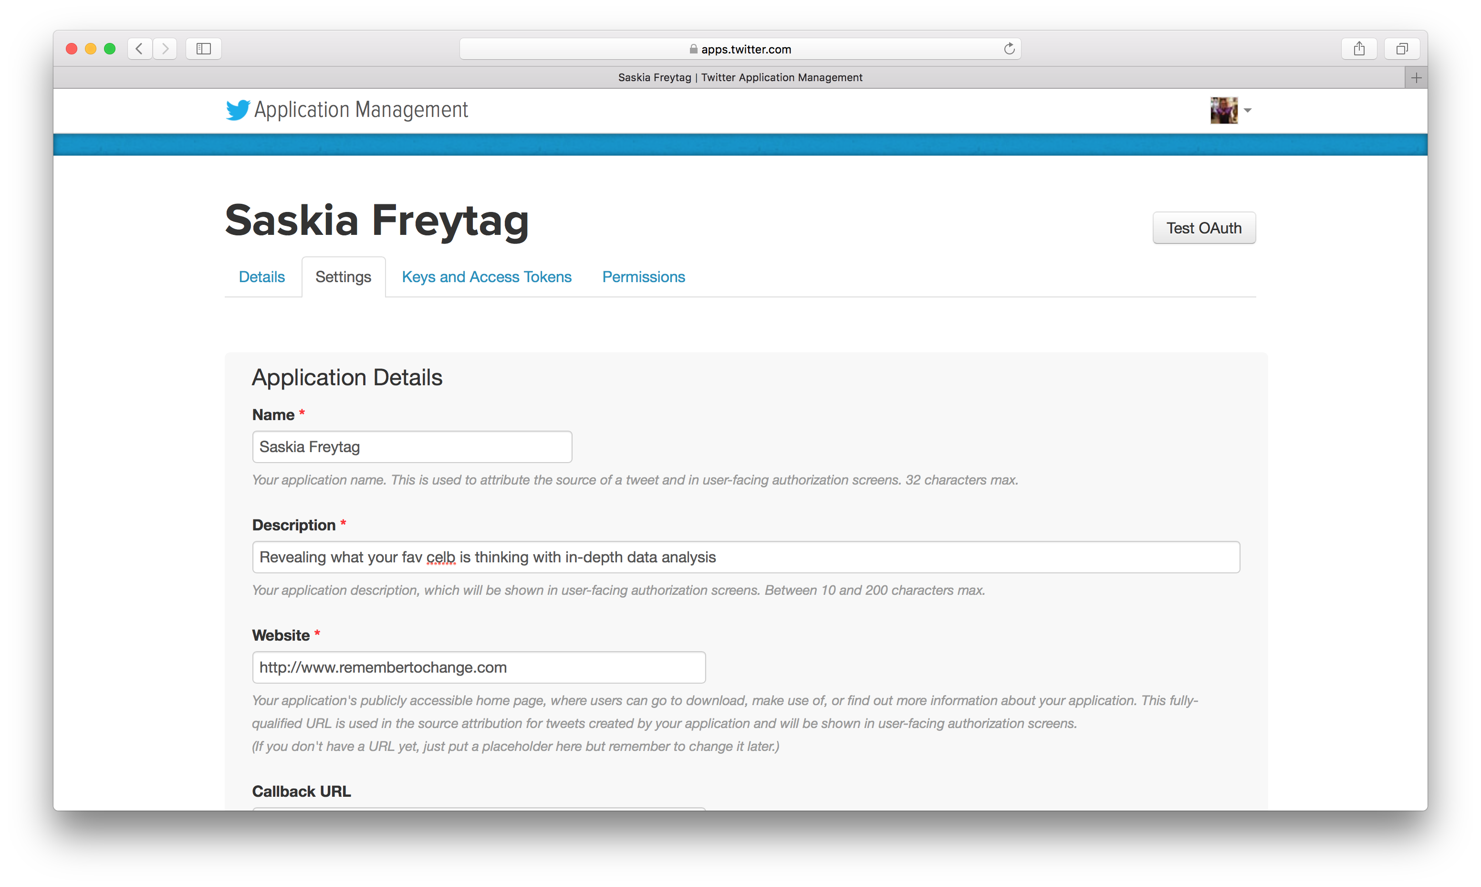
Become a twitter developer and get an API
Get a twitter account
Apply for your twitter application at https://apps.twitter.com
Now get started!

Slide 8
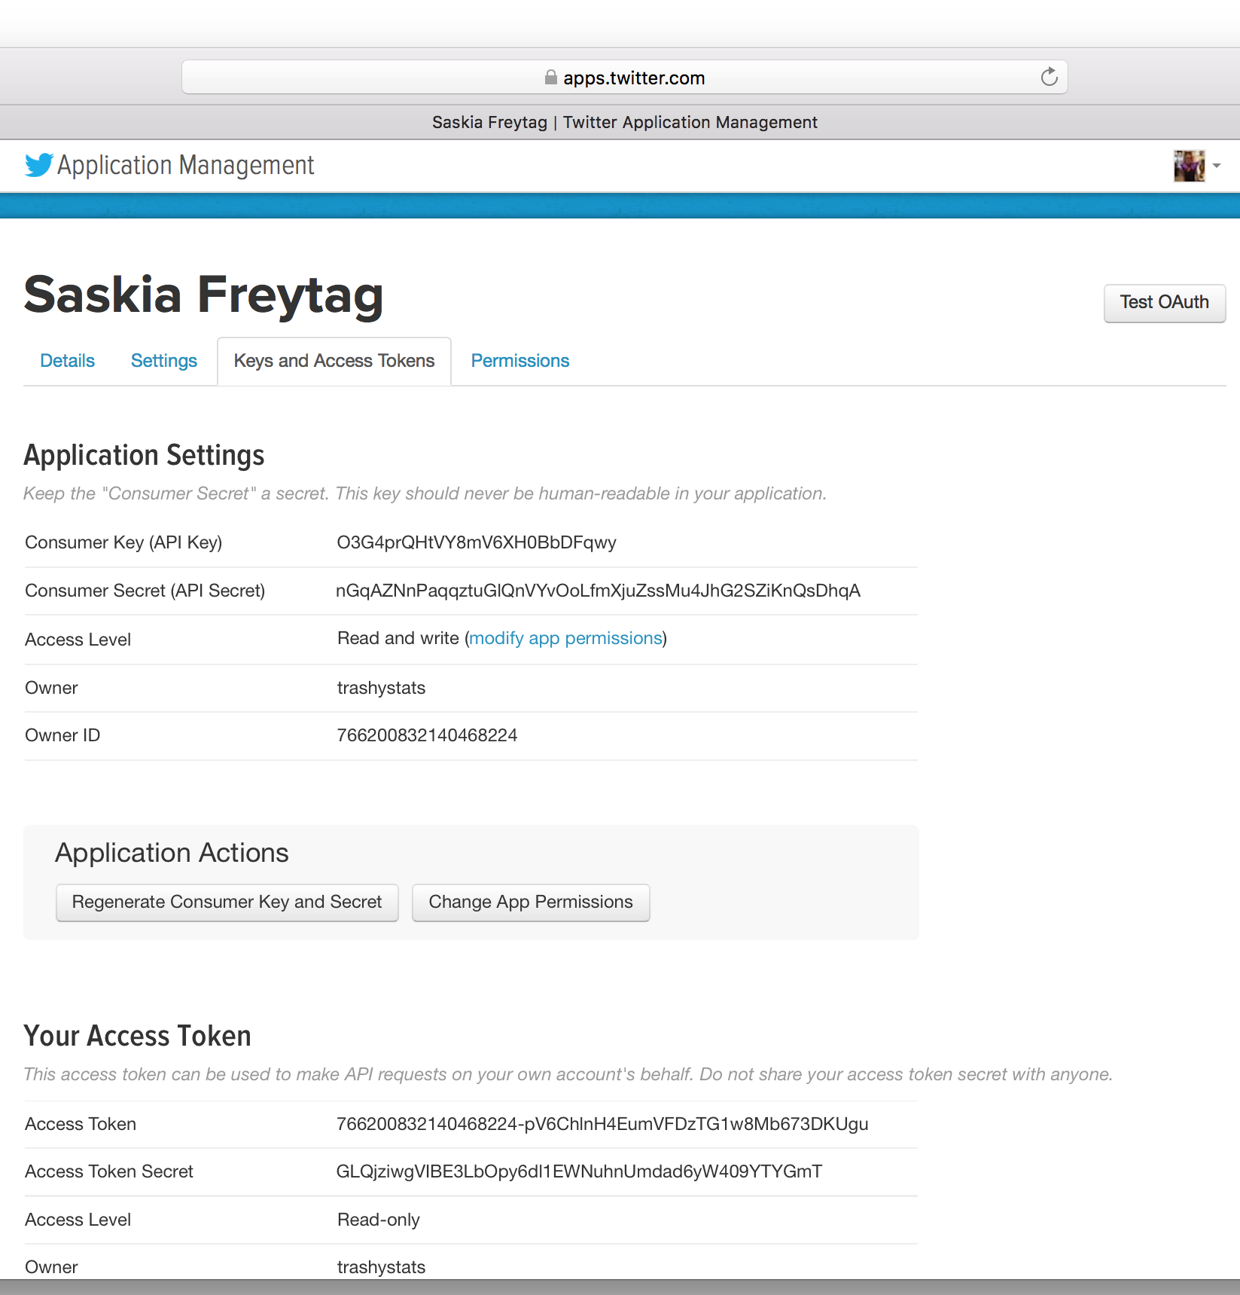
Keys, secrets and access tokens
Note your consumer key and secret
Generate access token
Note your access token and secret

Slide 9
Set up direct link between twitter and R
library(twitteR)
library(ROAuth)
library(RCurl)
library(RJSONIO)
api_key <- ’yourapikey’
api_secret <- ’yourapisecret’
token <- ’youraccesstoken’
token_secret <- ’yourtokensecret’
setup_twitter_oauth(api_key, api_secret, token, token_secret)
Create and store twitter authenticated credentials

Slide 10
3.
Searching twitter

Slide 11
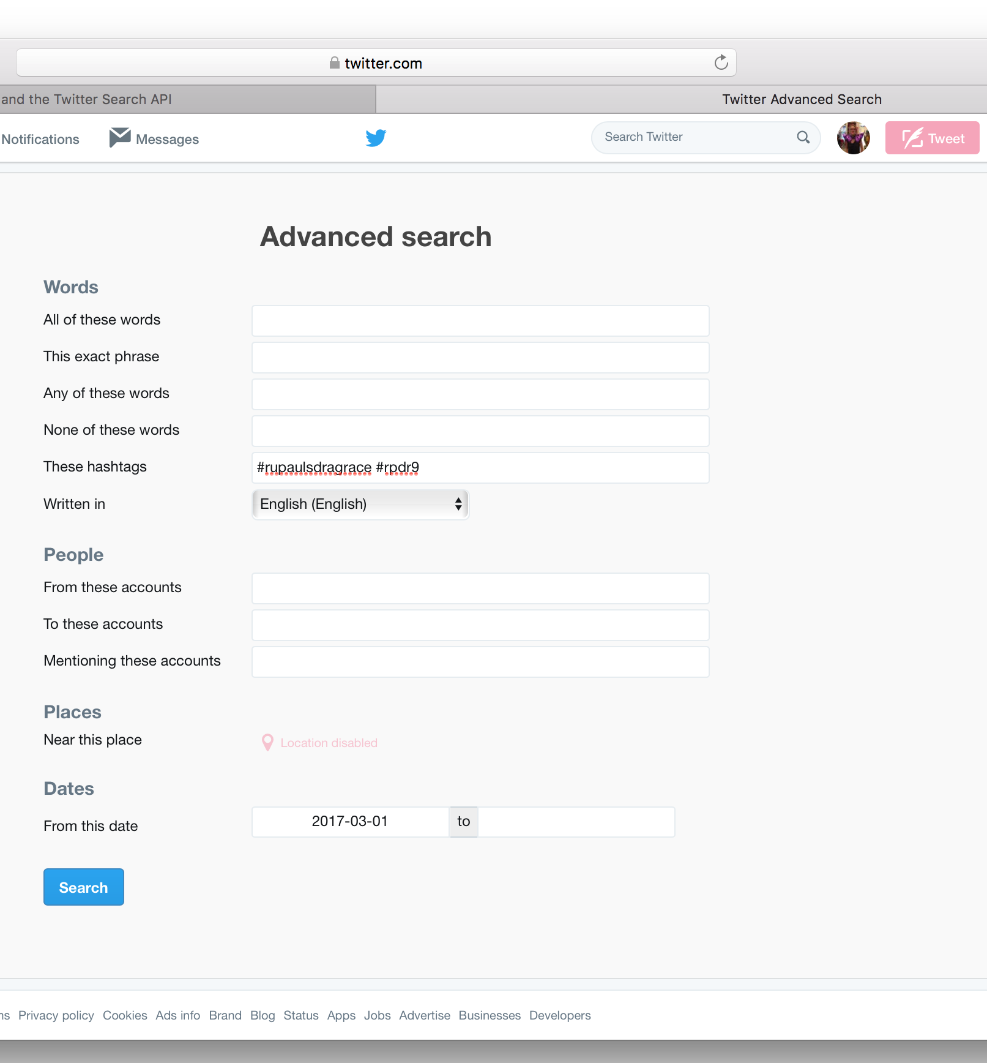
Always search twitter first and then set up R query
tweets <- searchTwitter( "#rupaulsdragrace OR #rpdr9" , lang = "en", since = "2017-03-01")
tweetsDF <- twListToDF(tweets)

Slide 12
More search options and other queries
Operator | Behavior
RuPaul’s Queens | will find tweets containing both "Queens" and ”RuPaul’s"; not case sensitive
‘RuPaul’s Queens’ | will find tweets containing the exact phrase "RuPaul’s Queens"; not case sensitive
rupaulsdragrace –rpdr9 | will find tweets containing ”rupaulsdragrace" but not ”rpdr9”
#rpdr9 | will find tweets containing the hashtag ”rpdr9"
from:RuPaul | will find tweets sent from Ru Paul
to:RuPaul | will find tweets sent to Ru Paul
@RuPaul | will find tweets referencing Ru Paul’s account
RuPaul since:2014-08-25 | tweets containing ”RuPaul" and sent since 2010-08-25 (year-month-day)
RuPaul until:2014-08-22 | will find tweets containing ”RuPaul" and sent before 2010-08-25
retweets returns retweets or users who retweeted a tweet
getTrends allows you to interact with the trend portion of the Twitter API

Slide 13
Get user information and combine
screen_names <- unique(
as.character(tweetsDF$screenName))
user_infos <- lookupUsers(screen_names, includeNA = FALSE)
lapply(user_infos, function (x) Encoding(x$lastStatus$text)
<- "latin1")
user_infosToDF <- twListToDF(user_infos)
combined_data<-merge(x=tweetsDF , y=user_infosToDF, by="screenName")
Find user information
Change encoding if necessary
Make data frame
Combine data frames by screen name

Slide 14
4.
RuPaul’s Drag Race Analysis

Slide 15
#rupaulsdragrace #rpdr9

Slide 18
So Ladies Start Your Engines And May the Best Woman Win!

